Slide 1
The Hasmonean Dynasty (Part 1) 167-37 BC
Mi chamocha ba'elim YHWH
Exodus 15:11

Slide 2
5 Successive Empires Ruled the World 1. The Assyrian Empire (911-609 BC) 2. The Babylonian Empire (609-539 BC) 3. The Persian Empire (539-333 BC) 4. The Grecian Empire (333-146 BC) 5. The Roman Empire (146 BC-AD 476)

Slide 3
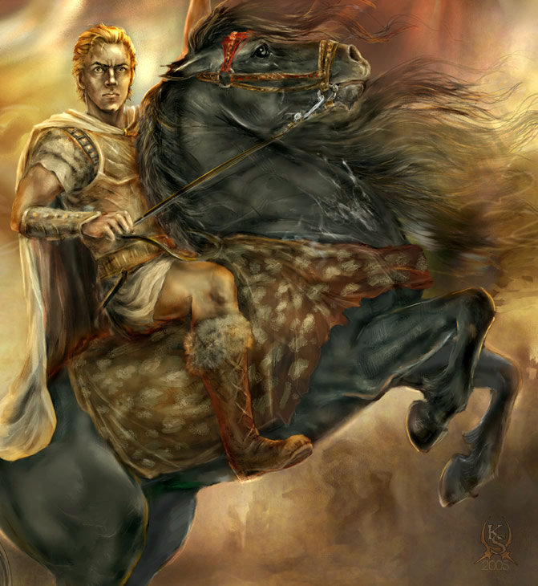
Alexander the Great (356 – 323 BC)

Slide 4
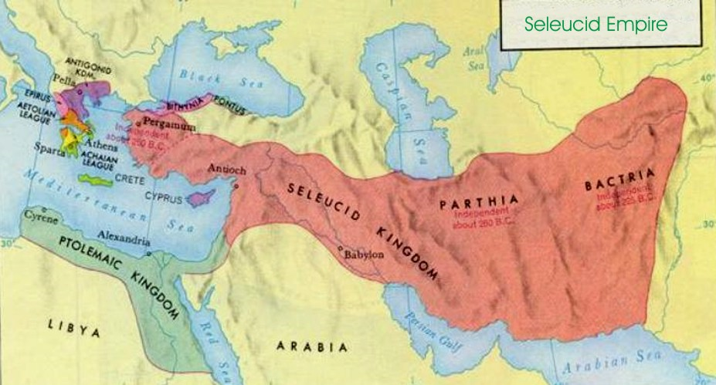

Slide 7
Antiochus IV Epiphanes (175 – 164 BC)

Slide 8
Antiochus Epiphanes forbade 3 Jewish practices:
The rite of circumcision
The study of the Torah
And the keeping of kashrut (Jewish dietary laws).

Slide 9
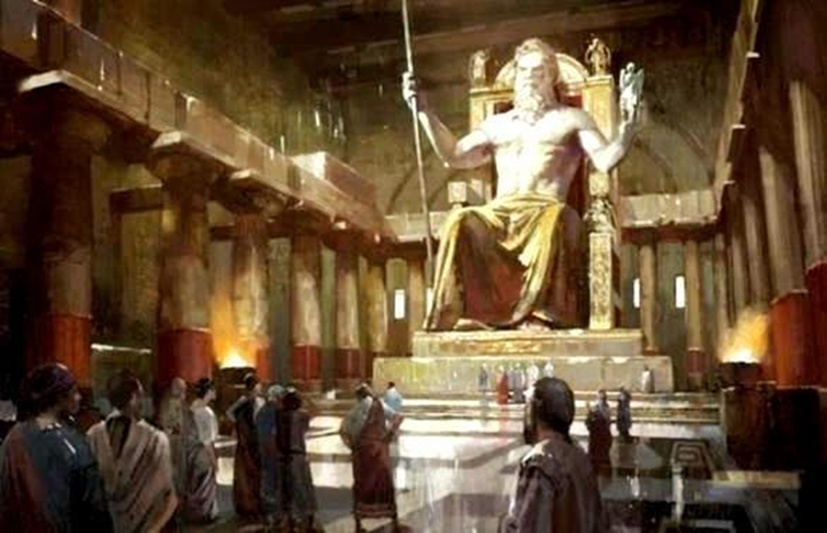
In December of 167 BC, the Seleucid (Greek) Emperor Antiochus Epiphanes erected a statue of Zeus in their temple and Hellenic priests began sacrificing pigs to Zeus.

Slide 10
“The abomination of desolation” (Daniel 11:31)

Slide 11
The 130-year period of Hasmonean influence in the land of Judea (167-37 BC) is the most significant but least understood Jewish time period for Christians (I and II Maccabees).

Slide 12
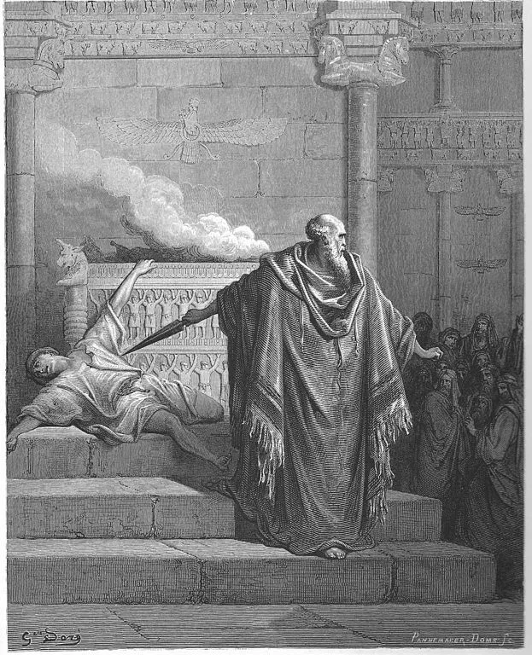
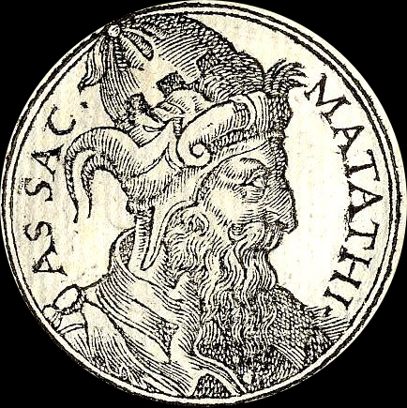
Mattathias of Modein, Son of Hasmon

Slide 13
I Maccabees 2:27 Mattathias cries out, “Let everyone who has a zeal for the Law and who stands for the covenant follow me!” This is the beginning of The Maccabean Revolt December 167 BC

Slide 14
Mi chamocha ba'elim YHWH "Who is like You among the heavenly gods, LORD!“ Exodus 11:15

Slide 15
Mattathias had FIVE Sons: “John, who was called Gaddis, and Simon who was called Matthes, and Judas, who was called Maccabeus, and Eleazer, who was called Auran, and Jonathan, who was called Apphus.” (I Maccabees 2:2-5)

Slide 16
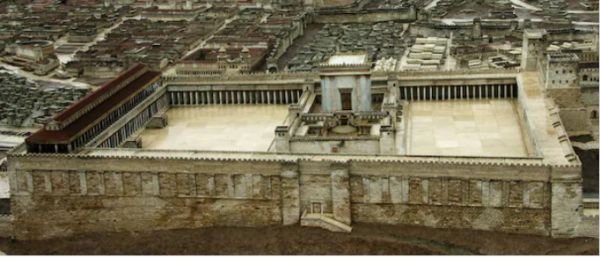
Re-Dedication of the Temple in Jerusalem 164 BC

Slide 17
The Word Hanukkah in Hebrew Word Is “Chanukat” and It Means “Dedication”
Psalm 30:1
mizmor shir chanukat habayit l’David
“A song for the dedication of the House of David.”

Slide 18
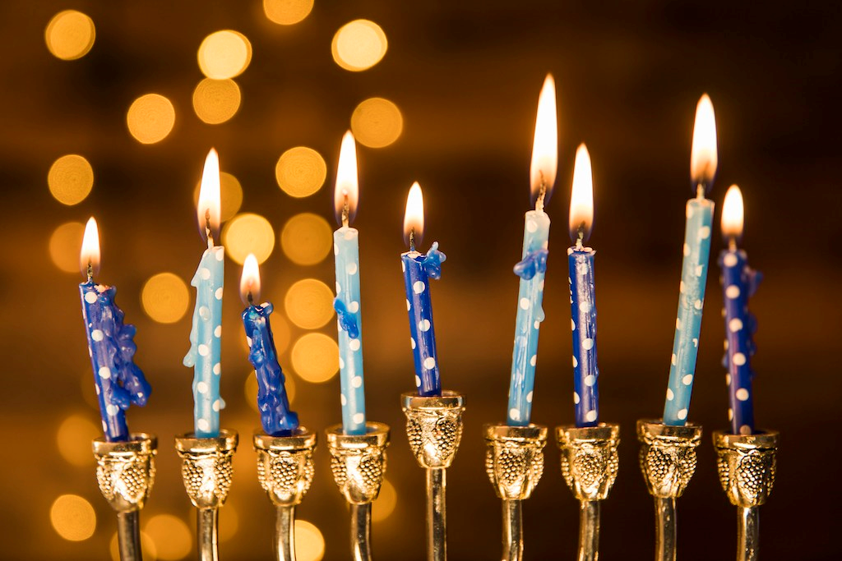

Slide 19
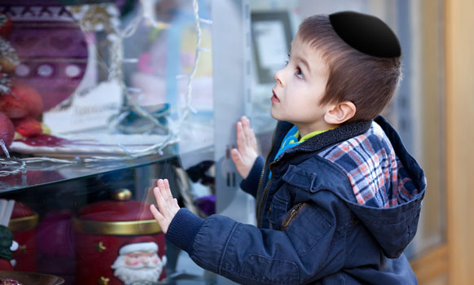
Hanukkah Is an Eight Day Jewish Celebration in December that is NOT Christmas

Slide 20
Jesus visits the Temple during Hanukkah
John 10:22-23

Slide 21
Judas Maccabeus is the Jew that makes first contact with the Romans to form a treaty.
I Maccabees 8:1-4

Slide 22
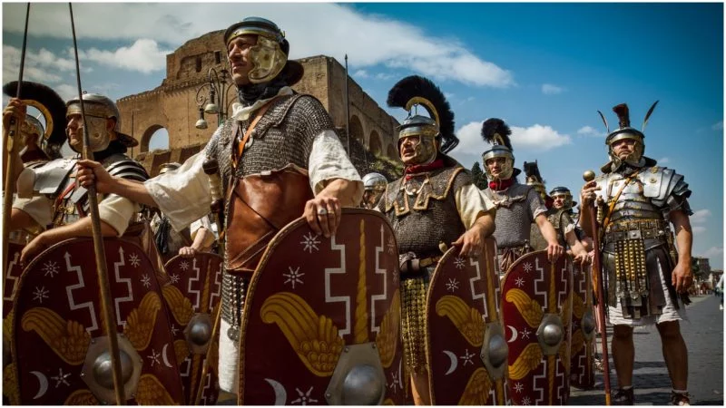
Josephus Writes Antiquities and War to Show Roman Ties to the Jews I Maccabees 8:17-20

Slide 23
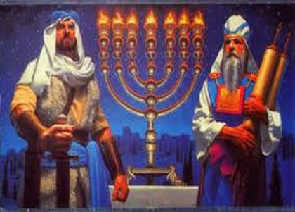
The Maccabean Revolt Continues for Two More Decades, with the Jews fighting the Greeks 16 7 BC to 142 BC

Slide 24
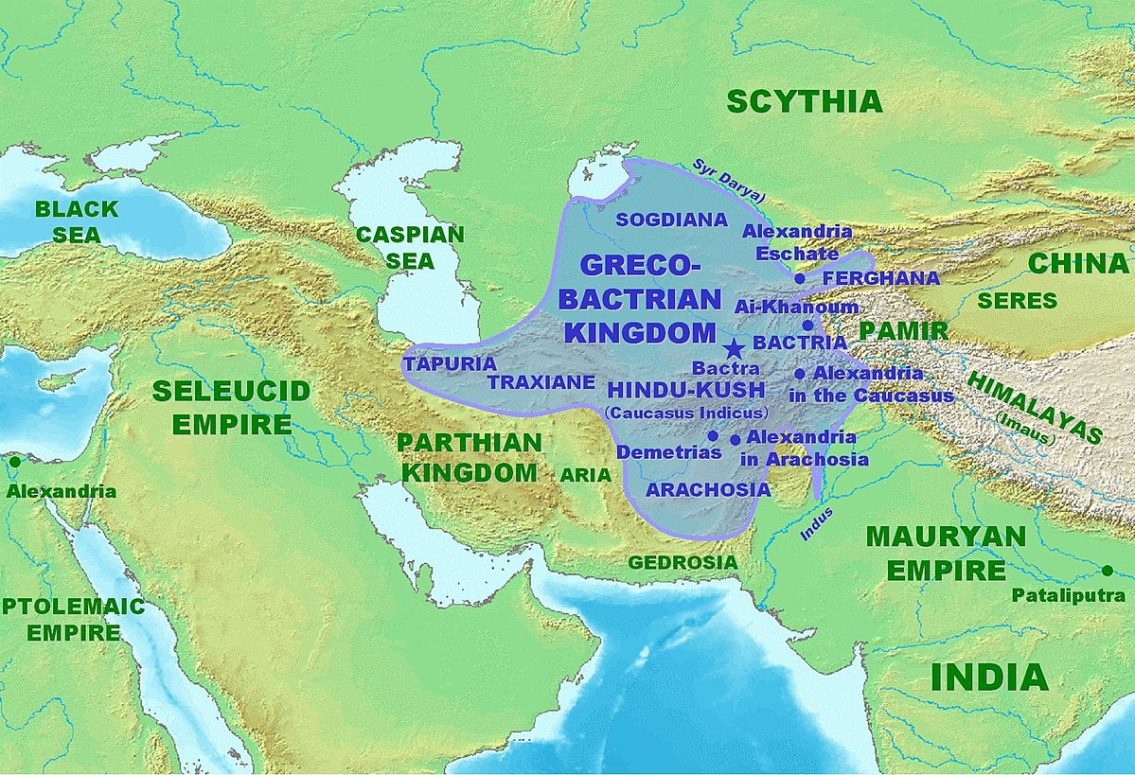
The Rise of Parthia and Bactrian

Slide 25
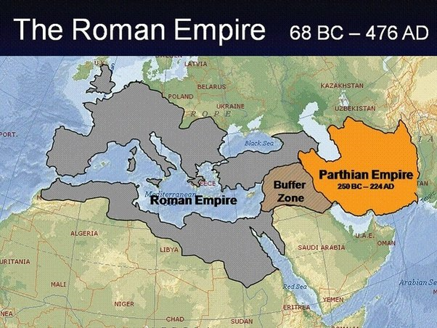
Rome and Parthia during the days of Christ

Slide 26
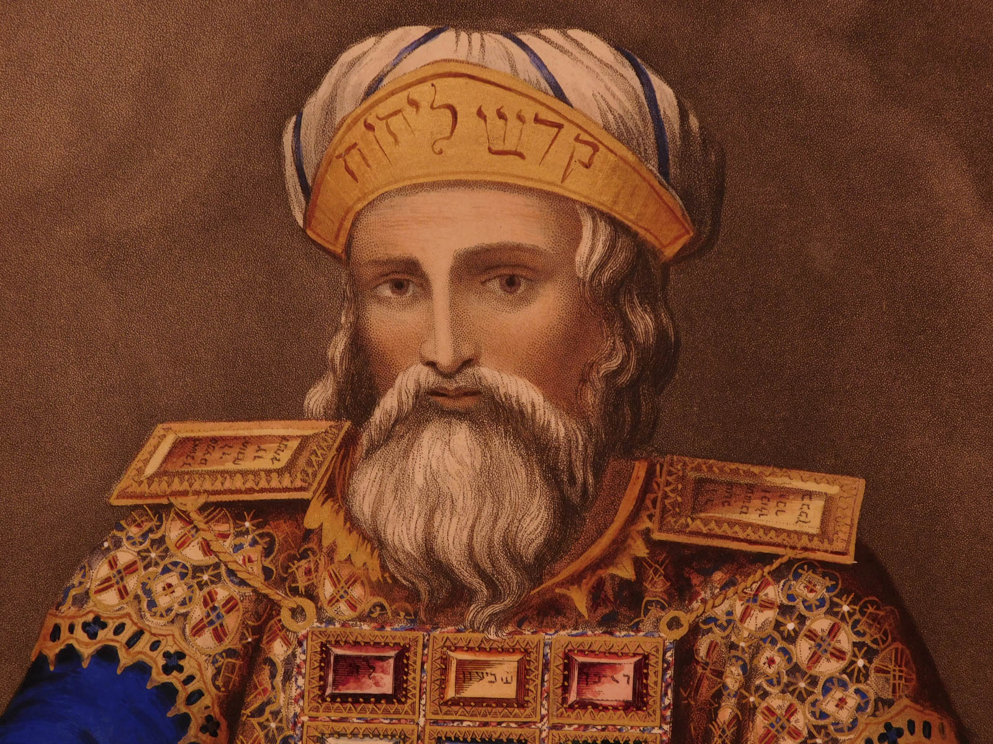
152 BC – Jonathan is appointed “High Priest” by the Greeks, though not a descendant of Zadok.

Slide 27
The House of Zadok – High Priest The House of David – Israel’s King Hasmoneans were from neither house.

Slide 28
In 142 BC, during the leadership of Simon Maccabees, the last surviving of the 5 sons of Mattathias, the Seleucid soldiers pull out of Judea and Antioch stopped taxing the Jews. Independence had come. Simon served as High Priest. Simon took the title “High Priest, ruler, and ethnarch of Judea.”

Slide 29
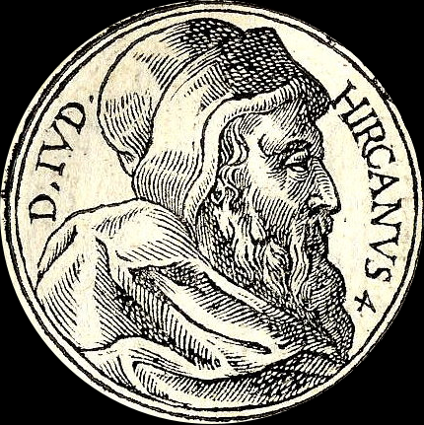
John Hyrcanus (135-104 BC), son of Simon

Slide 30
The 12 Hasmoneans Who Reigned for 130 Years
Matthatias (167-166 BC) – Began the War for Independence in 167 BC.
Judas Maccabeus (166-160 BC) – During whose reign, the Temple was retaken (Hannakuh)
Jonathan (160-143 BC) – Jonathan the first Maccabean to be high priest. He’s killed by Syrian general Tryphon.
Simon (143-135 BC) – Gains independence from the Greeks (142 BC). He is murdered by his son-in-law.
John Hyrcanus I (135-104 BC) – Simon’s son and Judea’s golden age. The Pharisees form to oppose the Maccabeans.
Aristobulus (104-103 BC) – Son of Hyrcanus. The first Hasmonean to declare himself King of the Jews. First since Zedekiah.
Alexandar Jannaeus (103-76 BC)– The brother of Aristobulus who married Aristobulus’ wife, Salome Alexandra.
Salome Alexandra (76-67 BC) – Upon the death of Alexandar Jannaeus, Salome became Queen, but could not serve
as high priest, so she appointed her son, Hyrcanus II, as high priest.
Aristobulus II (67-63 BC) – Son of Salome and Alexander. Fought his brother Hyrcanus II to be king and priest of Israel.
Hyrcanus II (63-40 BC) – Made priest by Pompei upon removal of Aristobulus II. Antipater (an Idumean) his righthand man.
Antigonus (40-37) – served as high priest (allied with the Parthians) after Hyrcanus II. When Herod conquered Jerusalem,
he sent Antigonus to Rome where he was beheaded.
Aristobulus III (d. 36 BC) - Served as High Priest of Israel at the age of 17. The last scion of the Hasmoneans. Drowned by
Herod, the Idumean, who had usurped the throne of Israel in 37 BC.

Slide 31
"Where is the one who has been born king of the Jews? We saw his star when it rose and have come to worship him.“ (Matthew 2:2) So Pilate asked Jesus, "Are you the king of the Jews?“ "You have said so," Jesus replied (Luke 23:3)

Slide 32
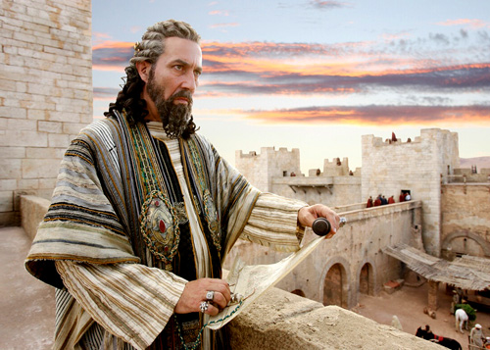
HEROD the GREAT

